Slide 1

GRAPH ANALYSER
Xtai Lab
Notes:
Today we’re going to present the result of the project which we developed
for me as XtAI lab 2 and for Maryam as lab 1

Slide 2

AGENDA
Backend – Mamad 🙋🏻‍♂️
Frontend – Maryam 🙋🏻‍♀️
Network Visualization – Nada 🙋🏻‍♀️
Notes:
Because we

Slide 3

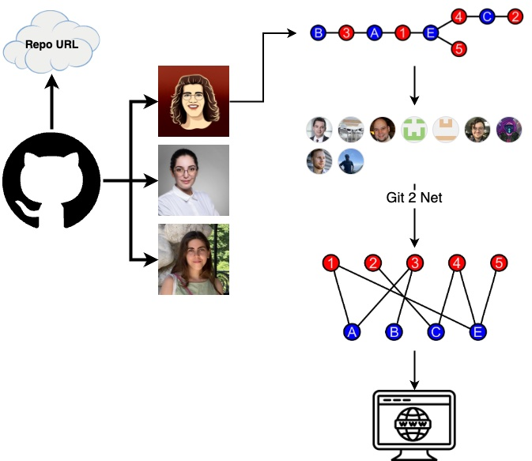
WHAT IS IT EVEN ABOUT?
Graphs from Repos
Notes:
We were working in somewhere between github repos and complex networks
As you can see we developed here in between an app which receives from git repo a complex netwrok
Anaysize and make it clean using git2net
And finally shows it to the end users

Slide 4
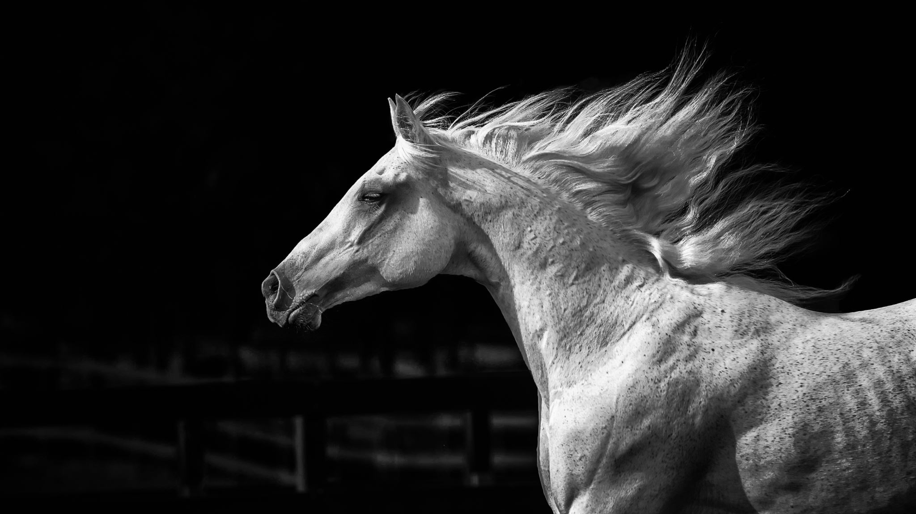
BACK-END
Notes:
Now I wanna talk in more detail about the backend part of the app
Project Management: Oversaw the project timeline, ensuring milestones were achieved.
Library Mastery
Learned and implemented git2net, pathpy, and NetworkX for data pre-processing, calculations, and analytics.
Data Analysis
Offered insights and intuitions into the collaboration network of a Git repository.
System Architecture
Took charge of designing the system's overall structure.
API Setup
Established the API endpoints using Flask.
Backend Development
Focused on clean, maintainable coding practices for backend implementation.
) Application: Ensured that each class/module had only one job, enhancing maintainability and scalability.
DocuSingle Responsibility Principle (SRPmentation
Wrote a README file, provided inline code comments, and ensured overall code readability.
System Visualization: Produced UML diagrams to represent system architecture.

Slide 5

BACKEND CORE TOOLS
Flask
Git2net
NetworkX
Pathpy
Notes:
These are the main tools which have been used in backend side

Slide 6

Notes:
Flask
Because at the end we wanted to user git2net and it’s Python based
To reduce compexity of component integrations I decided to use a Python based framework

Slide 7
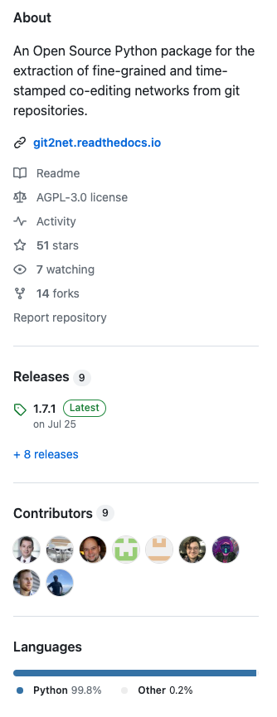
GIT2NET
Notes:
Git2net
It’s the core library which we used to analyse the git repo as well as the network

Slide 8
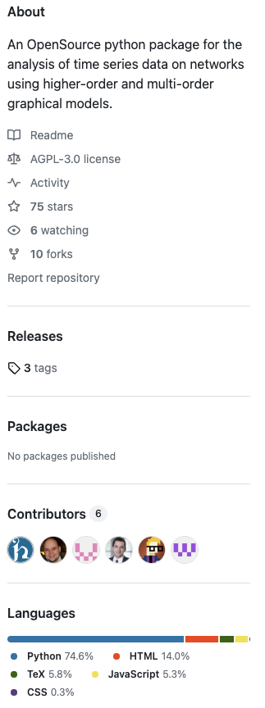
PATHPY

Slide 9
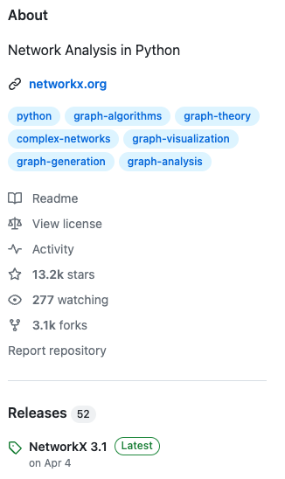

NETWORKX
Notes:
NetworkX
In addition to the analyse and visualization the app can show useful measurements like degree of centrality
Which the calculation are being done using NetworkX

Slide 10
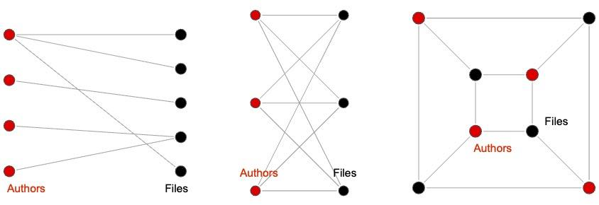
BIPARTITE GRAPHS
Notes:
Before we know more about the app it’s required to know what is Bipartite graphs
Graphs which edges can be divided to 2 groups
All edges connects sets together not edges of the same set

Slide 11
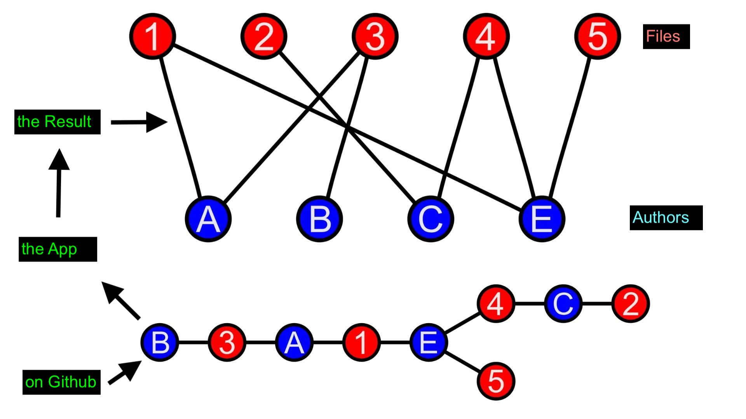
AUTHORS AND FILES NETWORK
Notes:
it’s basic visualization of the app
We receive complex network and unsorted data structre
Feed to the app
As a result we can have organized data structure and user-friendly bipartate network to show
In 1 side authors and another side files

Slide 12
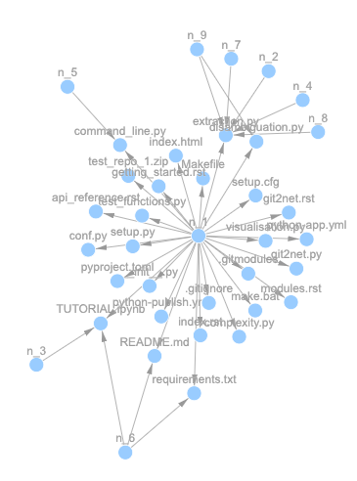
CO-EDITING NETWORK
Notes:
Just 3 days ago I added 3 extra endpoints to the base project because Nada needed them
That I could imagine these worth bonus points
Co-editing networks
Creates a network of authors who edited the same line of code.
Code-line level

Slide 13
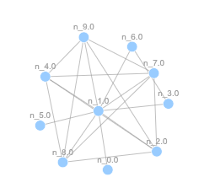
CO-AUTHOR GRAPH
Notes:
Creates a network of authors who edited the same file.
Collaboration between authors

Slide 14
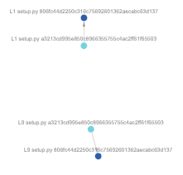
LINE EDITING PATHS
Notes:
tracks changes to specific lines in given files

Slide 15

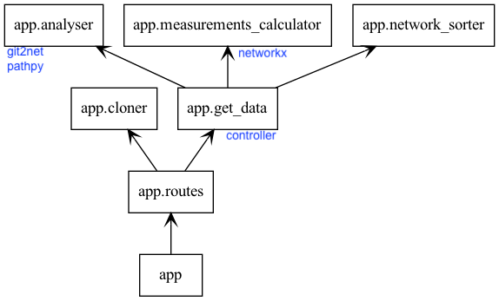
BACKEND ARCHITECTURE
SRP, Clean Architecture and Open for Extension(Future Work)
Notes:
Here is the arch of the backend
Because we’re in the university and it was a scientific project and I thought I should think of future work
and the future students which gonna develop firther this app
As you can see I tried to stick to the best practices like CA and SRP to make it easier for future development or maintanance

Slide 16
FRONT-END
BaseLine Bipartie graph

Slide 17

React Js

Slide 18
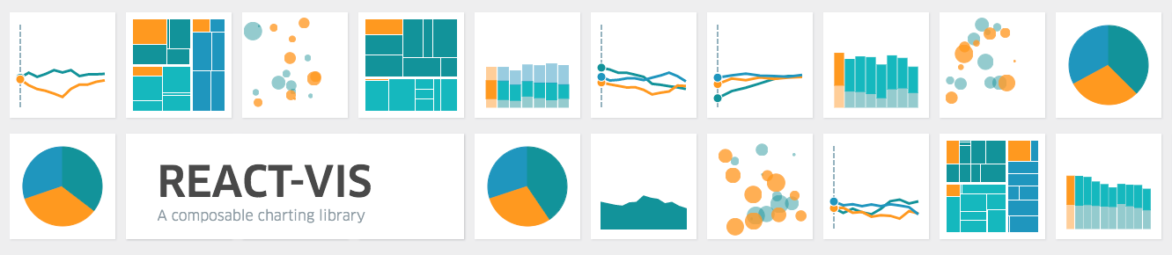

Useful Libraries

Slide 19
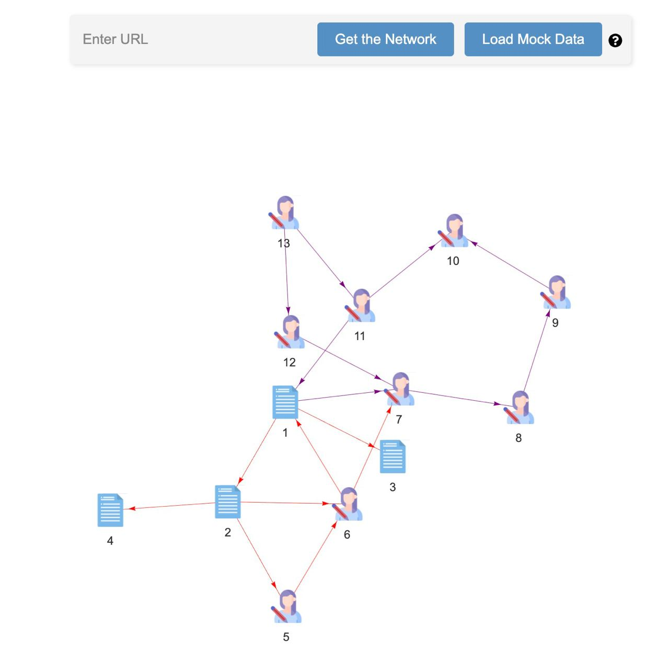
Home Page
URL bar
Mine_repo api
Offline result
Helper
Interactive Graph

Slide 20
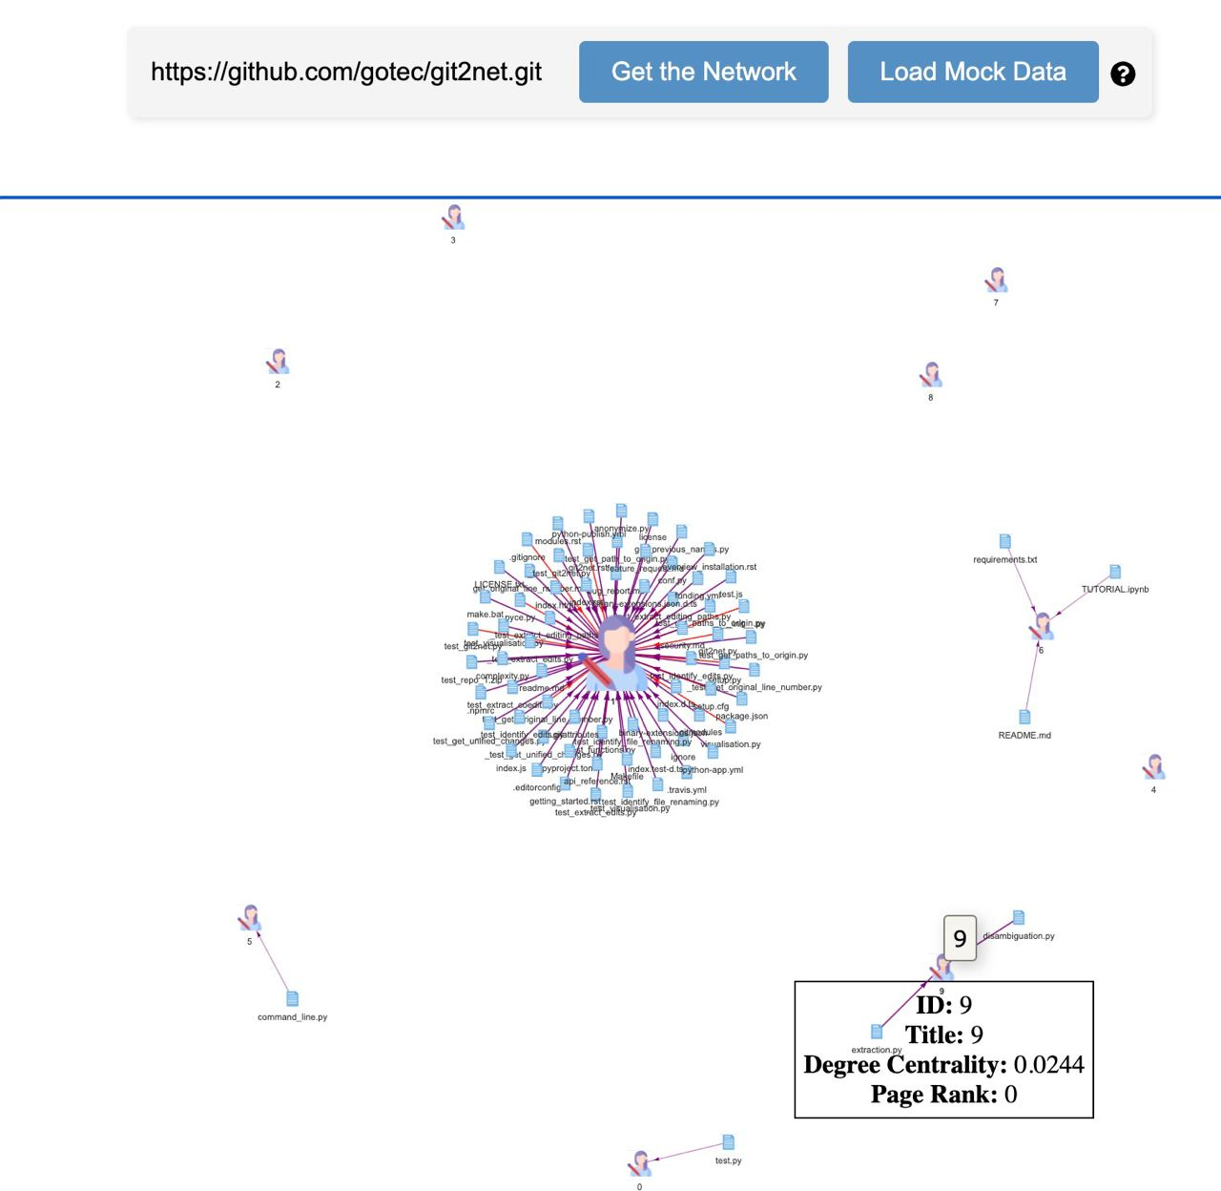
Get Network
Interactive Graph
Bipartite
Parser

Slide 21
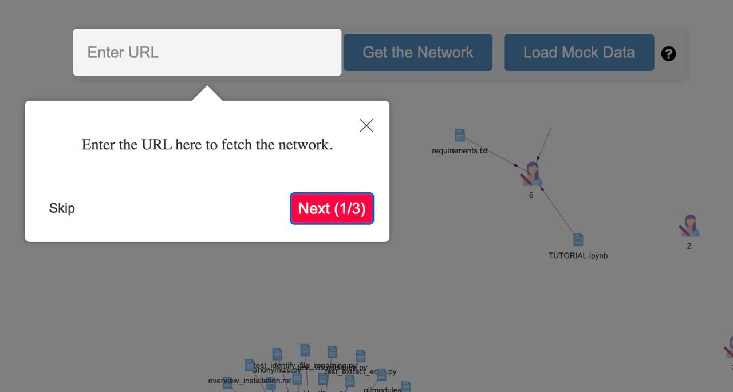
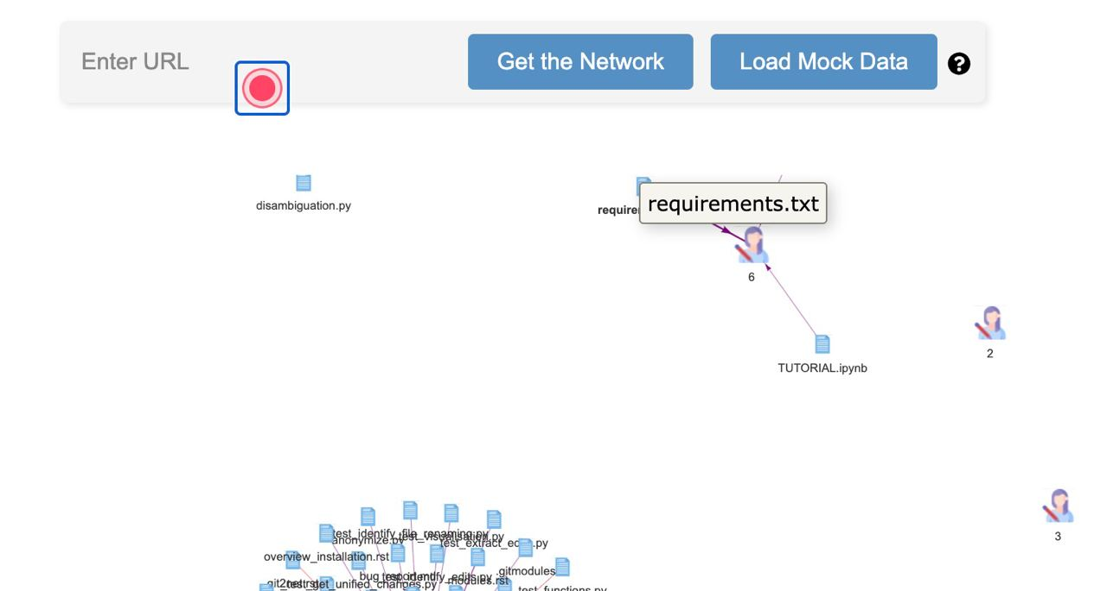
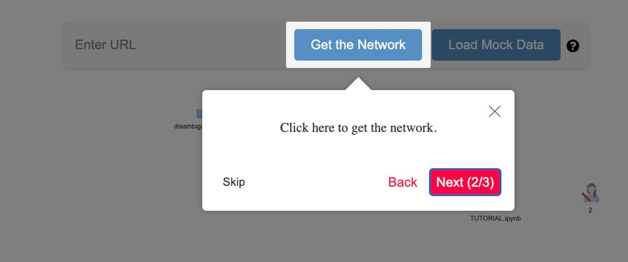
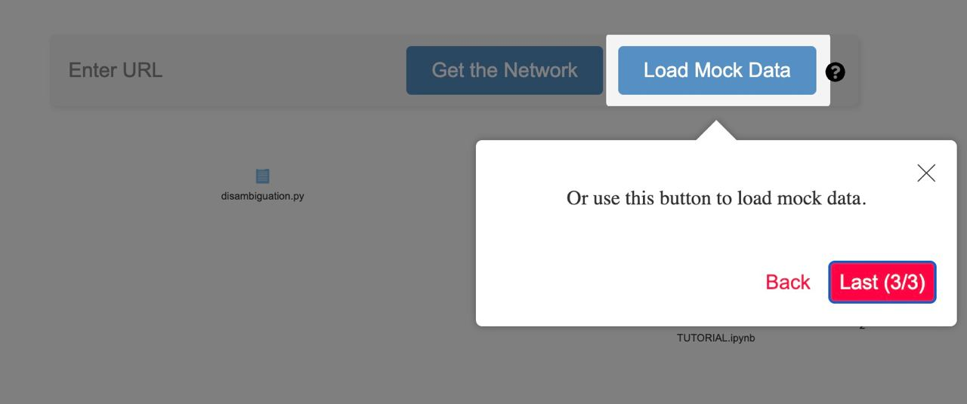
Helper-Joyride

Slide 22
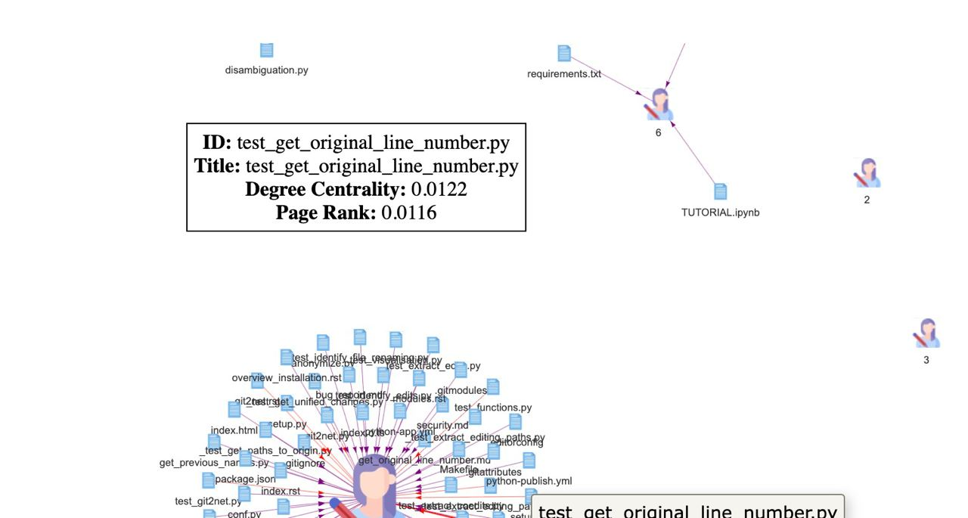
Hovering
Corresponding size

Slide 23
Frontend - Network visualizations

Slide 24
Backend and Frontend Integration
Virtual environment setup
Install git2net
Flask app setup
React packages – npm start
Notes:
Frontend send request to the backend, where the response is sent as a json object

Slide 25
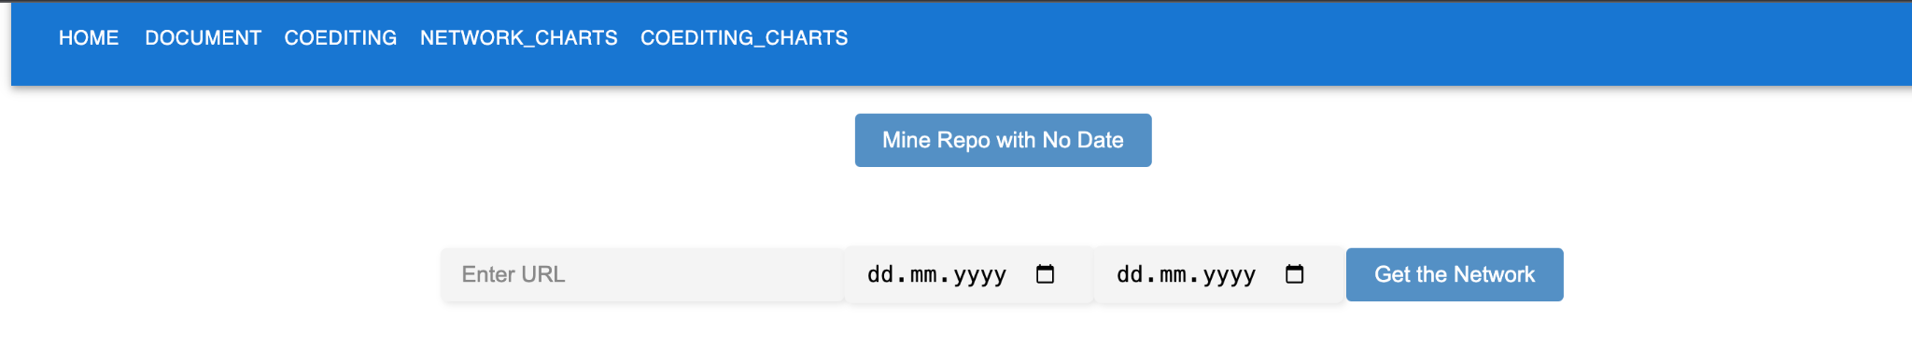
Frontend Infrastructure
React Components
Navigation bar: links and pages
Routes: <Route path="/" element={<Home />} />
App.js

Slide 26
Communication between Frontend and Backend
Frontend initiate an API request:
const response = await fetch('http://127.0.0.1:5000/mine_repo_with_date', {
method: 'GET',
headers: {
'Content-Type': 'application/json',
'url': url,
'fromdate': fromDateToBeSent,
'todate': toDateToBeSent
}
Backend processes the request
Backend sends a json response
RequestURL:http://127.0.0.1:5000/mine_repo_with_date
Request Method:GET
Status Code:200 OK
Remote Address:127.0.0.1:5000
Header: URL, dates

Slide 27
Data Preparation in Frontend
Json Response:
Status: Indicates the success or failure of the request.
200 OK or fail.
Data: Contains the actual information being sent.
Network nodes and edges.
Data:
{message: "Repo mined successfully",…}
edges: {file: {weight: 37, connected_to: 1}}
first_commit_date: "2019-01-08"
last_commit_date: "2023-07-25"
measurements: {author_degree_centrality: {1: 0.71875, 3: 0}, {file_degree_centrality:{__init__.py: 0.03125}}}
message: "Repo mined successfully"
nodes: {1: {inweight: 0, outweight: 216, indegree: 0, outdegree: 28},…}

Slide 28
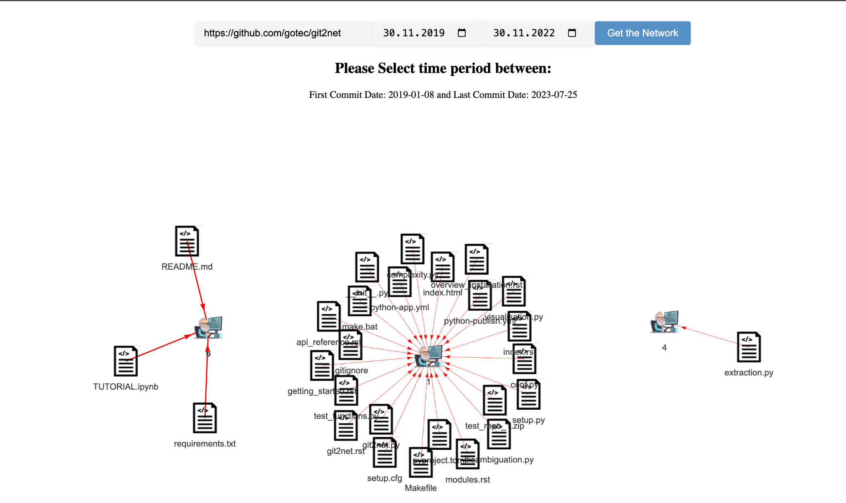
Network Visualization - Repo mining with temporal input 1
The Network:
Nodes: Authors, Files
Edges
first and last commit date
Measurements

Slide 29
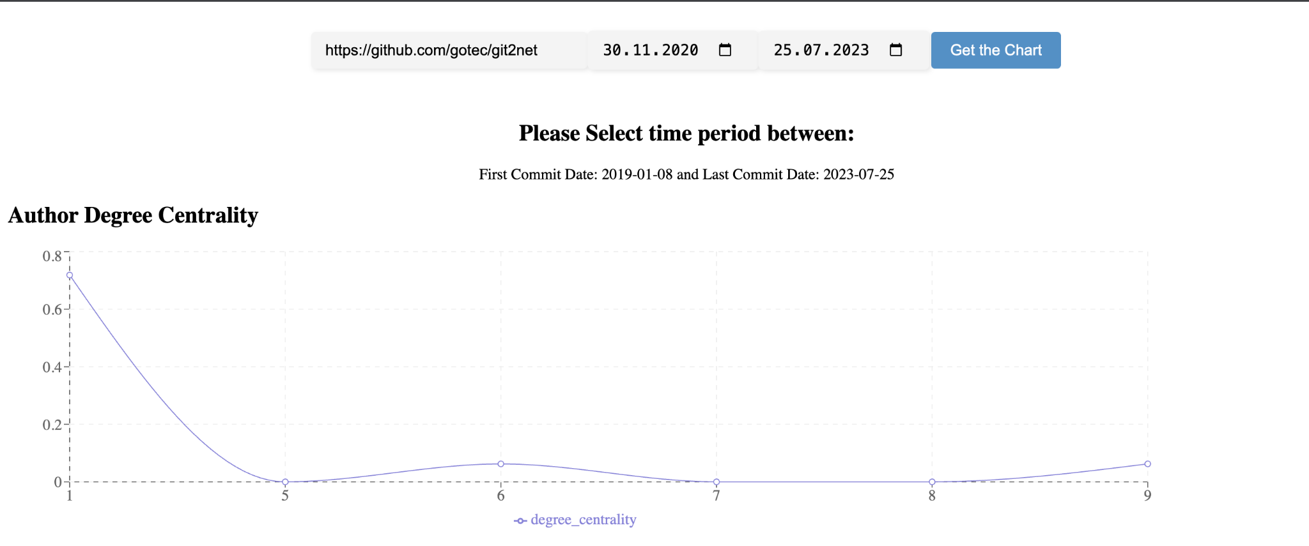
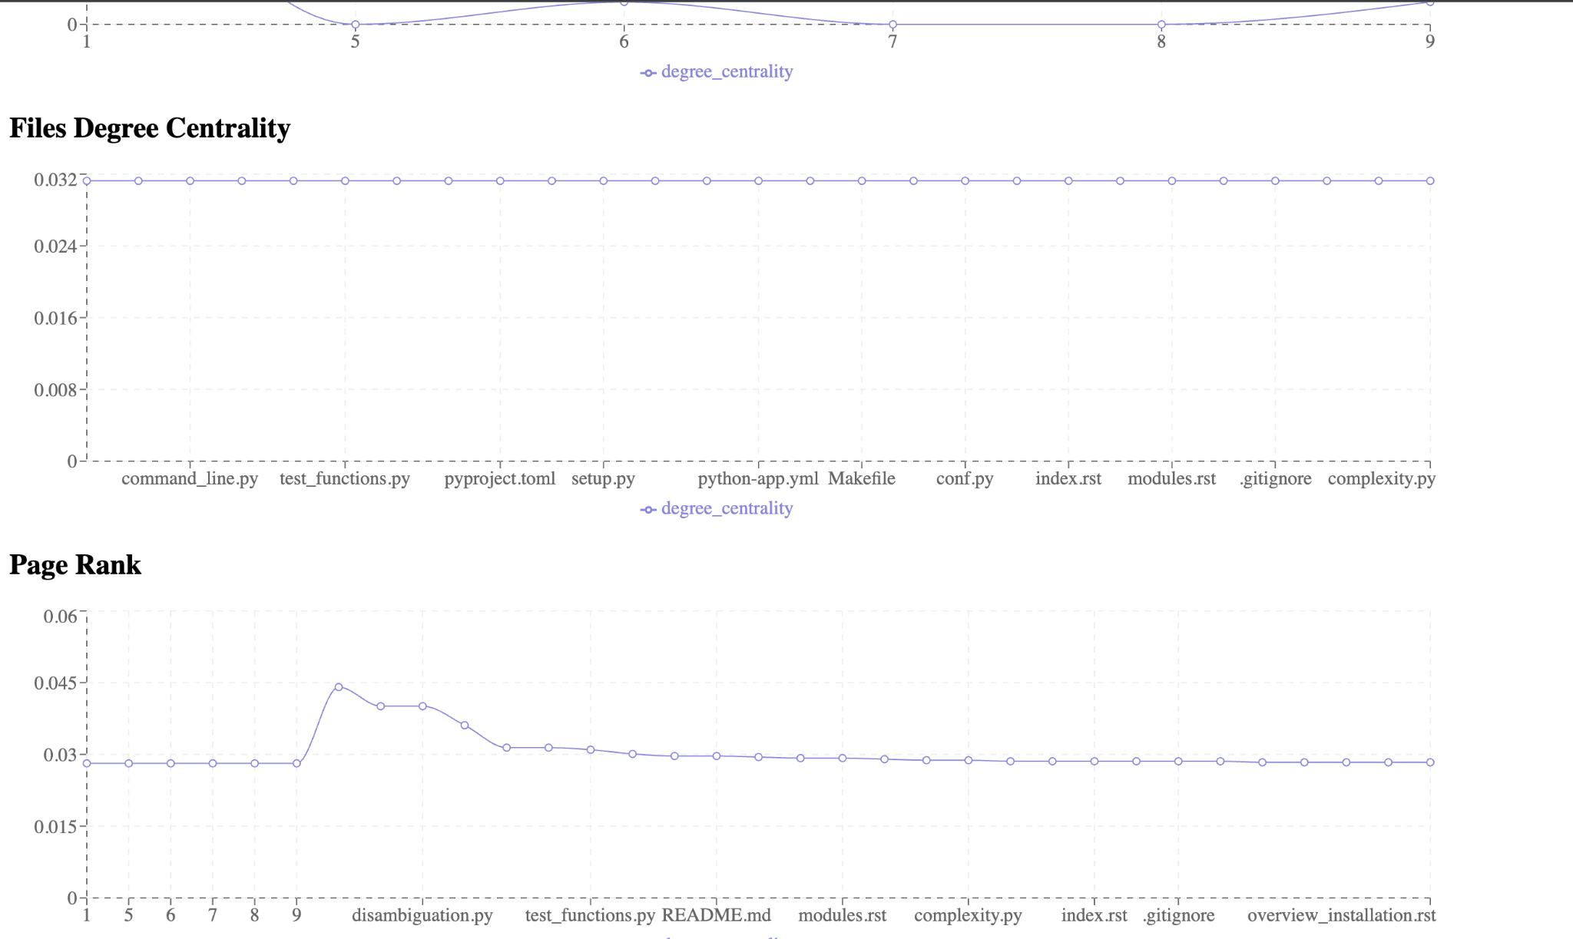
Further Network Visualization 1
Data measurements visualization
Author Degree Centrality
File degree centrality
Page Rank

Slide 30
Network Visualization - Line editing path 2
Data Processing
The edges consist of two-pair key and value.
The two pair key represent the source and target node (node From, node to) and the value is the weight of the edge.
Processing the data using split method and removing the characters by:
key.match(/'(.*?)'/g).map(str => str.replace(/'/g, ''))
The Response:
dag_data: {edges: {
('L1 setup.py a3213cd995e850c8966355755c4ac2ff61f65503', 'L1 setup.py 806fc44d2250c316c75692601362aecabc63d137'): "{'weight': 1.0}"},
nodes:{L1 setup.py 806fc44d2250c316c75692601362aecabc63d137: {inweight: 1, outweight: 0, indegree: 1, outdegree: 0}}}

Slide 31
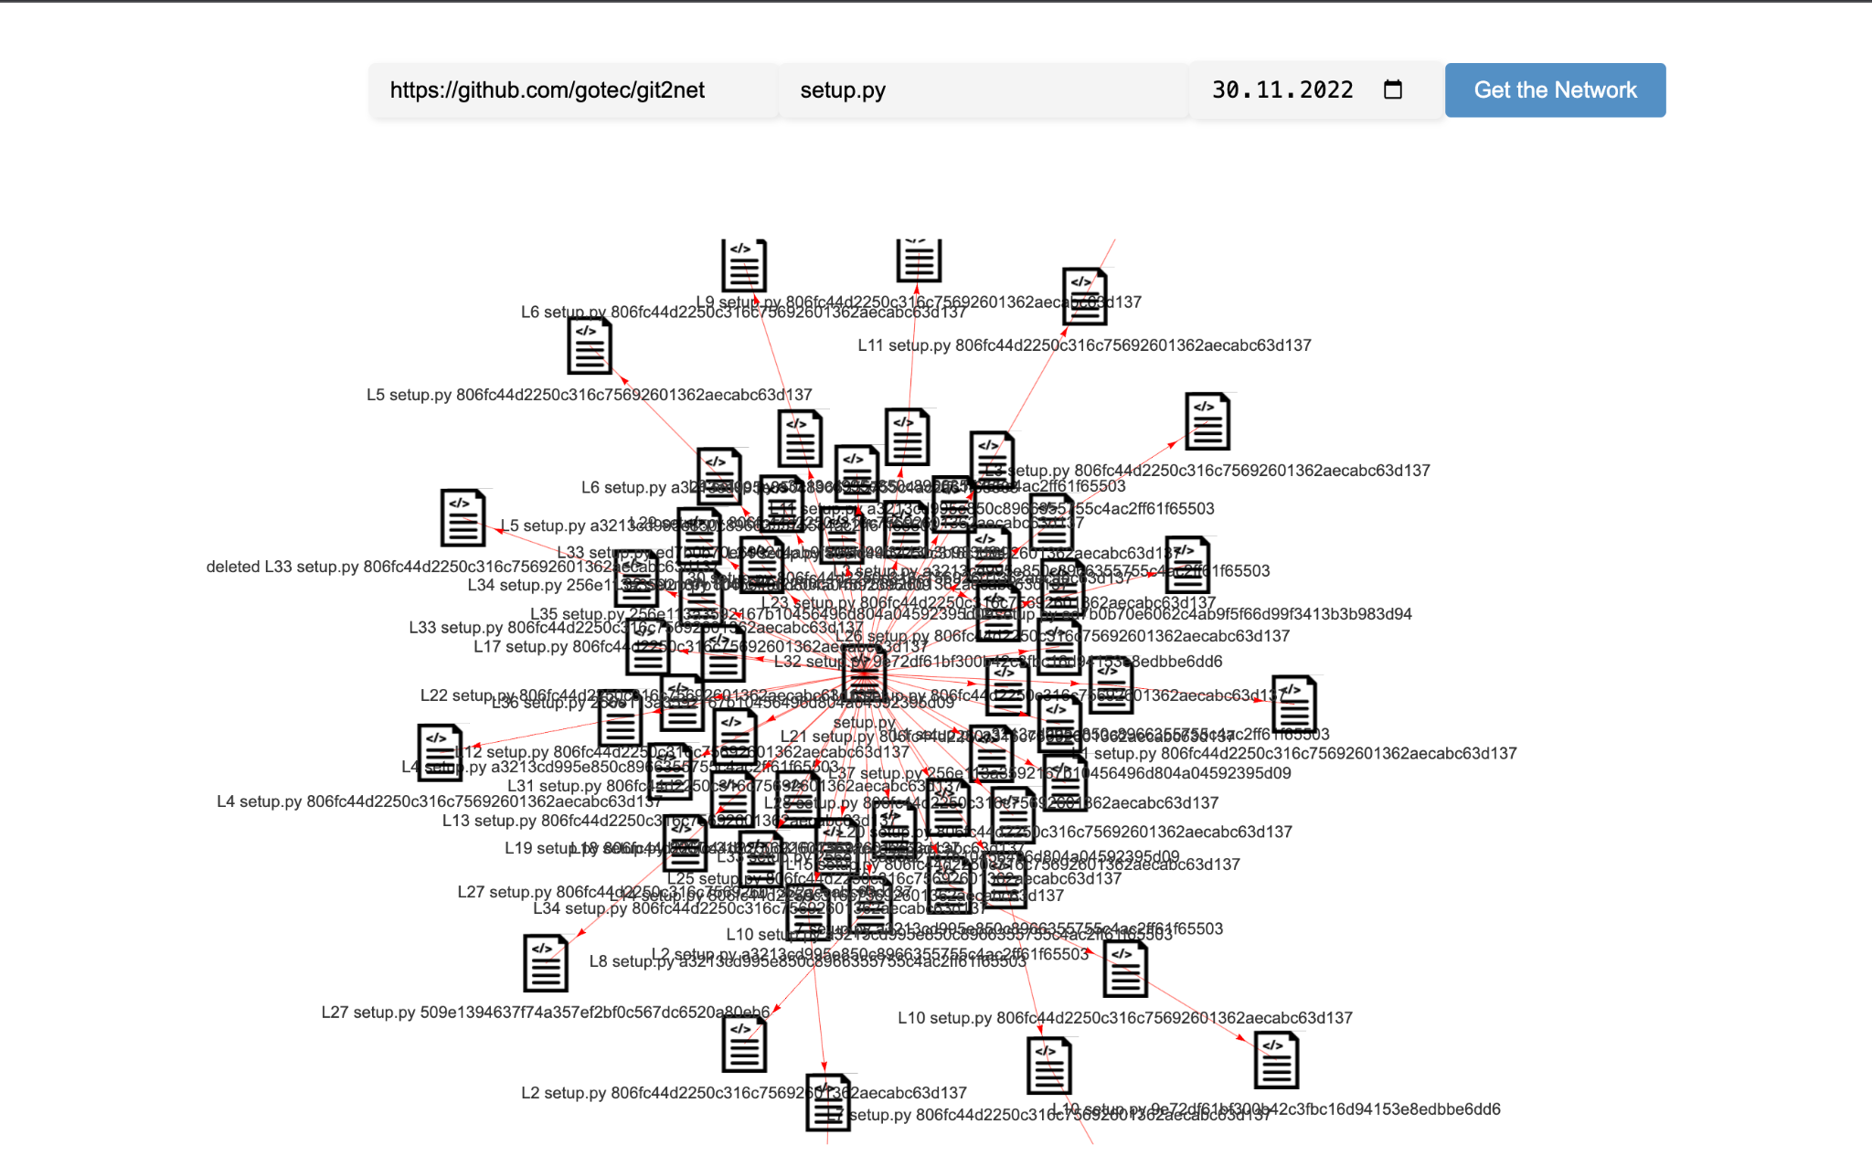
Network Visualization - Line editing path 2
Showing the commit path for a specific
file.

Slide 32
Network Visualization - Coediting Network 3
The Response:
edges: {0.0: {weight: 245, connected_to: 1},..},
measurements: author_degree_centrality: {1: 0.5555555555555556, 2: 0.1111111111111111,…},page_rank: {1: 0.13640937696957958, 2: 0.08921004787363597, ..}
nodes: {1: {inweight: 361, outweight: 533, indegree: 8, outdegree: 5},…}
Data Processing
The Network consists of nodes: Authors and edges between authors to show the coediting between two different authors on the repository files.
The edges data type: float
Nodes data type: Integer
ParseInt(Node_key) to visualise the edges

Slide 33
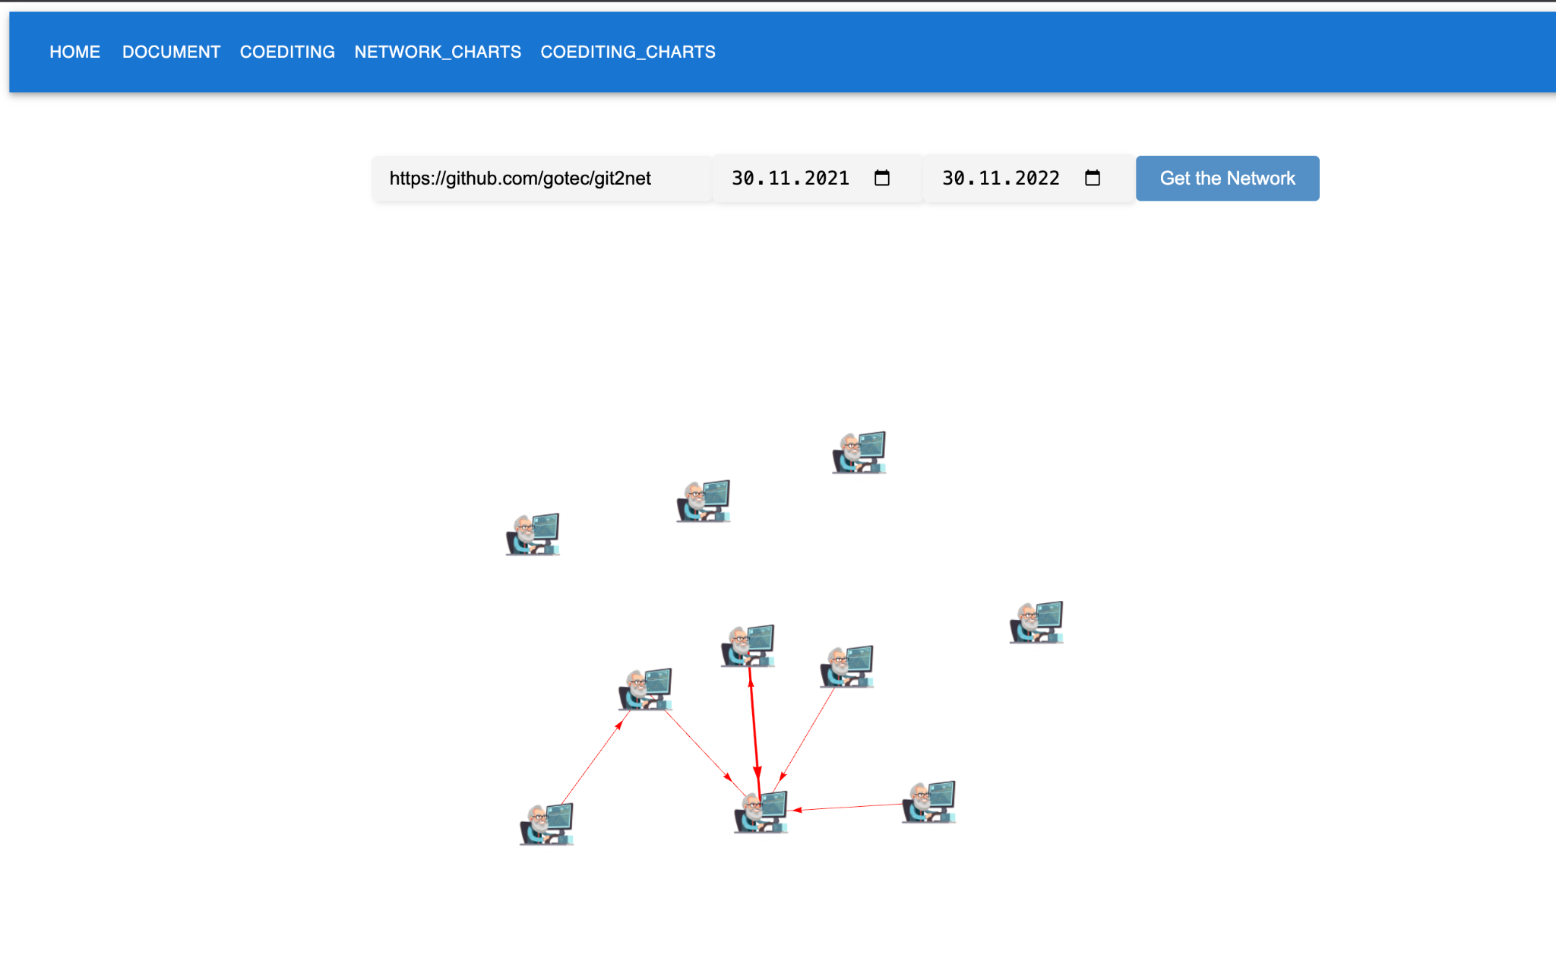
Network Visualization - Coediting Network 3

Slide 34
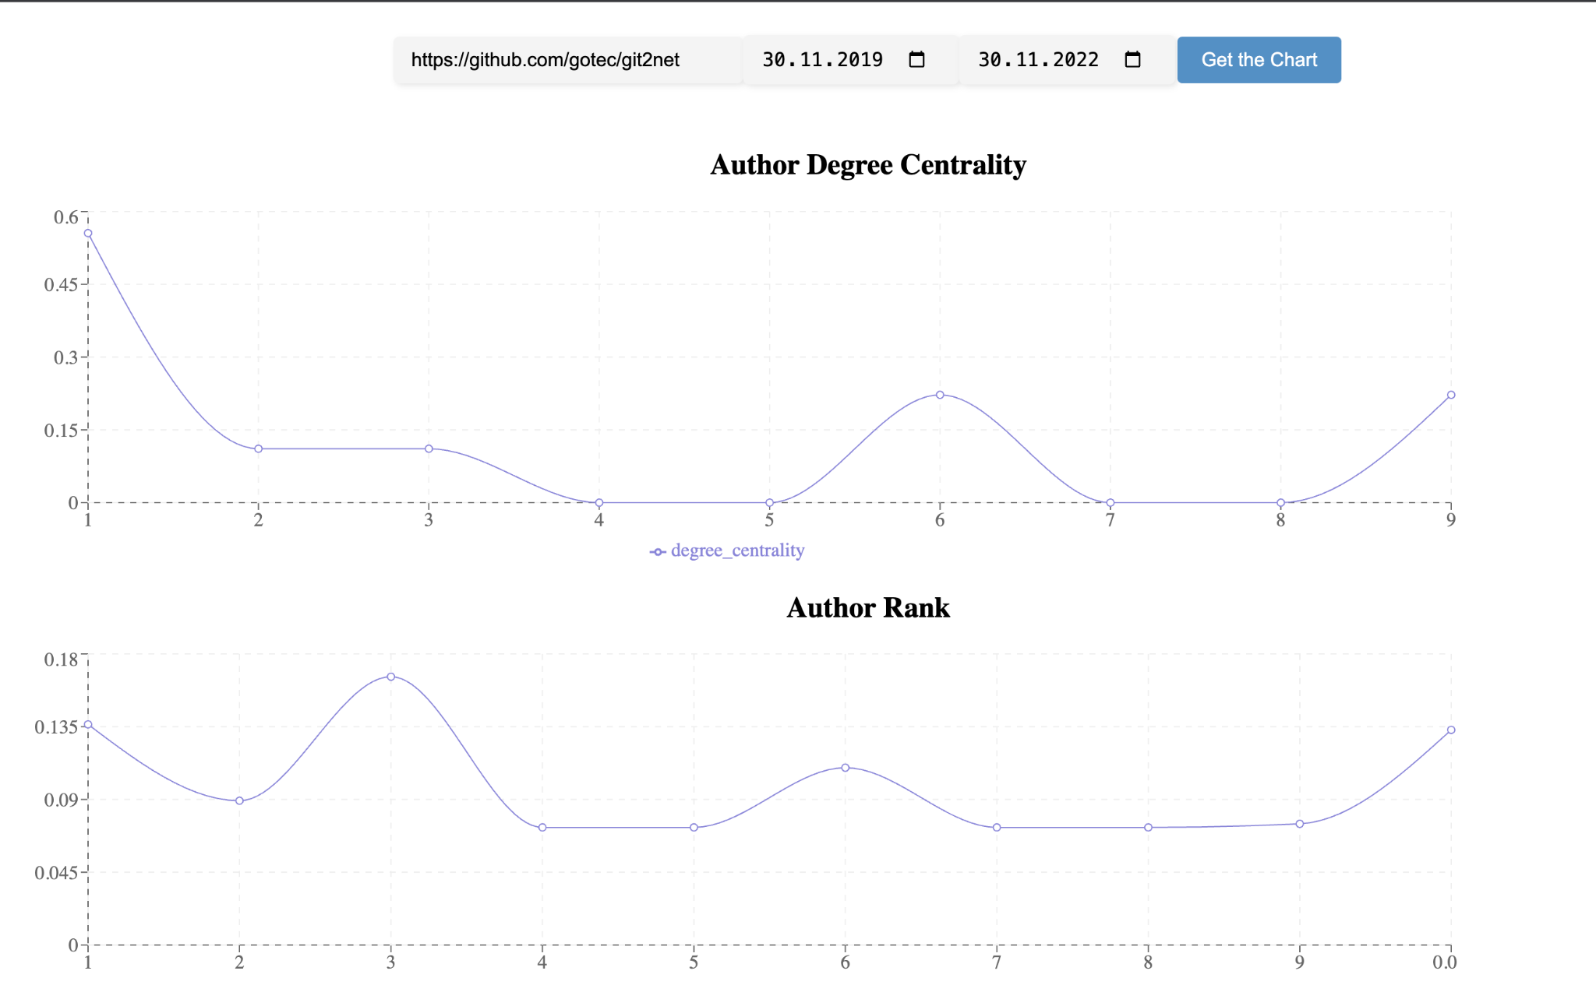
Further Network Visualization
Data measurements visualization
Author Degree Centrality
Page Rank

Slide 35

THANKS FOR YOUR ATTENTION!

